Slide 1







ROBOT
EDUCATION

Slide 2

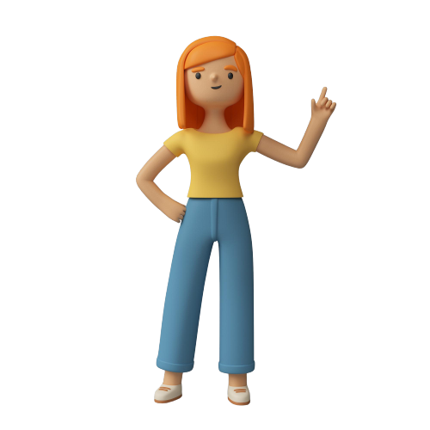
CONTENT
01
INTRODUCTION
02
PROJECT BACKGROUND
03
ENERGY OPTIMIZATION OVERIEW
04
POWER CONSUMPTION
05
ROBOT MODEL ENHANCEMENT
06
BMC
07
BUDEGTING
07
USED MATERIALS

Slide 3

Introduction :
AIMS to enhance young learners' educational experiences by refining and improving educational robots.
Objective: Address unique formative needs of students.
Approach: Inject vitality and innovation into traditional teaching methods.
Purpose: Breathe new life into the educational journey.
Cultivate an instructive, dynamic, and forward-looking educational environment for enhanced learning experiences.

Slide 4


Porject Background :
traditional and technological teaching methods.
workshops provided to all primary school years

Slide 5
ENERGY OPTIMIZATION OVERVIEW:
In this phase, our paramount goal is to revolutionize the educational robot's energy system Key goals include:
1. OPTIMIZING ENERGY CONSUMPTION:
2. EXPLORING RENEWABLE ENERGY SOURCES:
3. INTEGRATING "SMART SUNFLOWER" FOR
HARVESTING:
- Utilizing cutting-edge components and technology for energy-efficient refinement.
- Strategic adjustments for improved energy efficiency.
- Exploring renewables to shrink the educational robot's ecological footprint
- Emphasizing sustainable choices for a greener and eco-conscious operation.
- Innovatively incorporating the "Smart Sunflower" technology for intelligent solar energy harvesting.

Slide 6
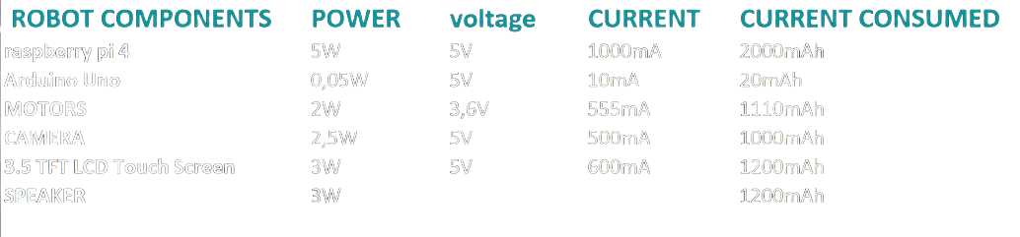

Power Consumption :
example:
Let's use the robot for 2 hours daily, as excessive use may cause issues for children, such as autism.
The calculations used:
I(mA) = P/V
I consumed(mAh) = I * Time (hours)
Total power = 15.55W (estimated based on the specifications)
Total consumed current= 6530mAh

Slide 7
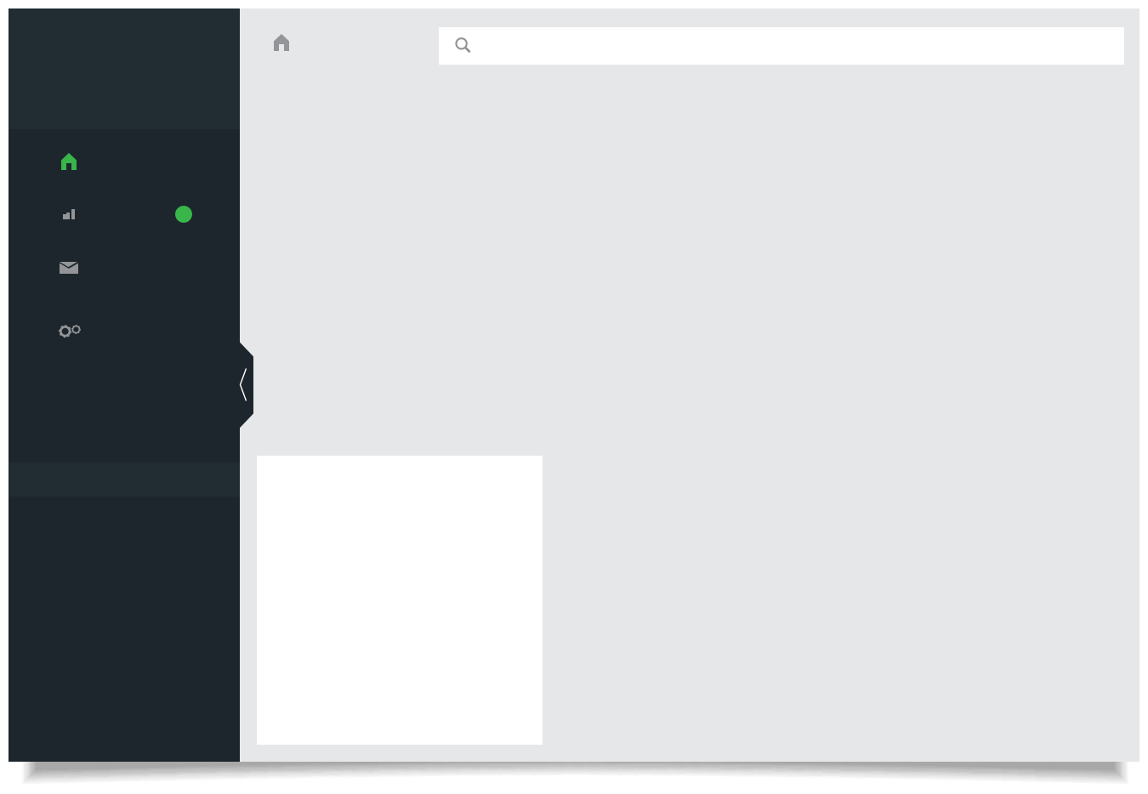
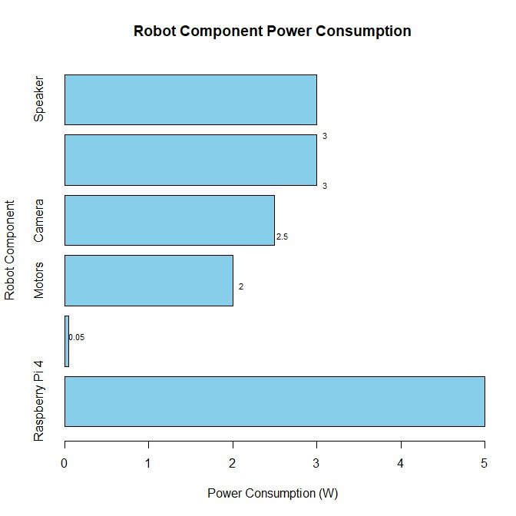
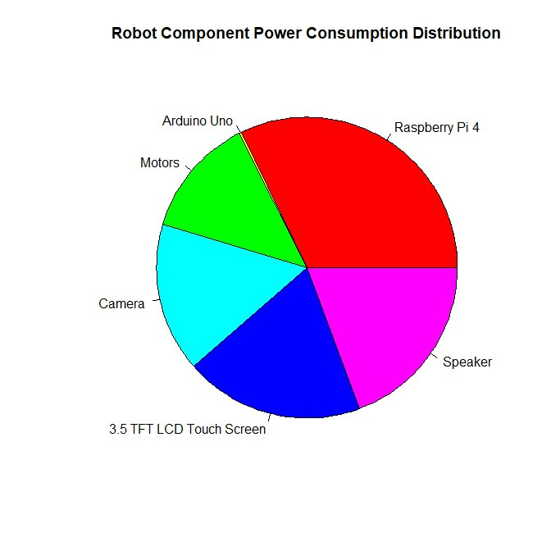
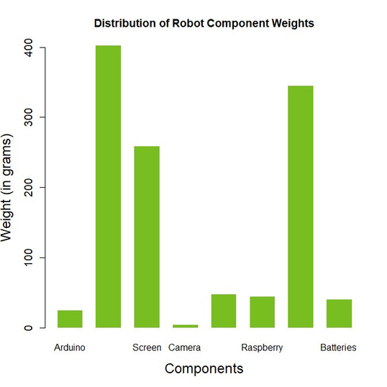
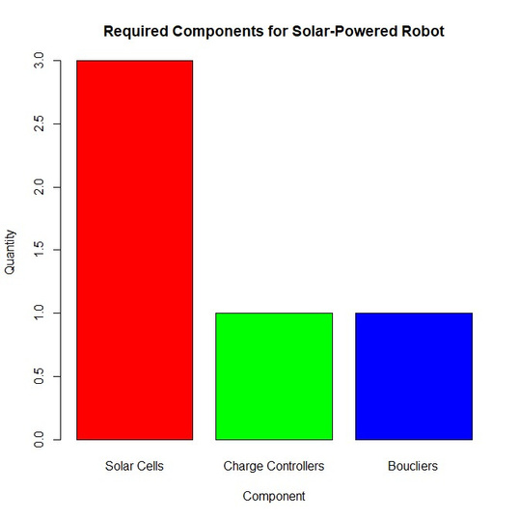
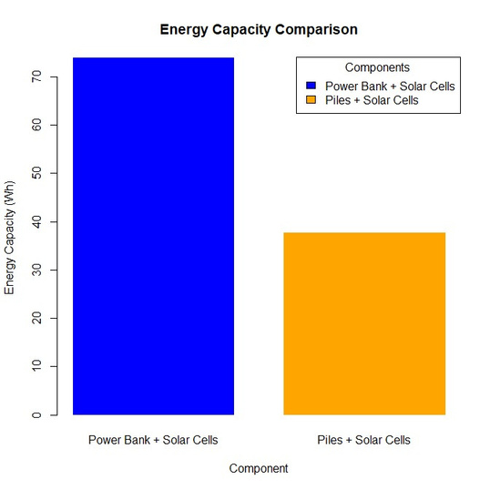
Dashboard
Search
Dashboard
Char t
2
Email
Setting
SIGN OUT

Slide 8

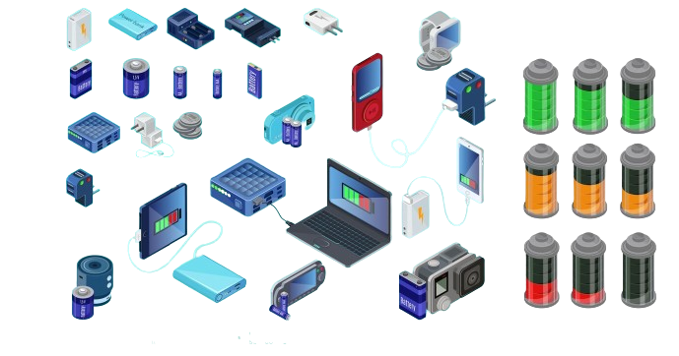
Why the mini solar Cells ?
The mini solar cells (12V 150mA ) is a central element in our optimization.
It enables efficient, sustainable, and eco-friendly power for the educational robot.
Compact design ensures seamless integration without compromising mobility.
Differences Before and After Optimization:
1. Before Optimization:
2. After Optimization:
High reliance on conventional power sources
Power Bank Energy Capacity: 37.00 watt-hours
Enhances sustainability and energy efficiency.

Slide 9
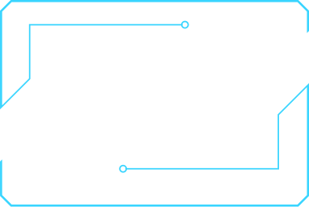
System Upgrades (IoT, AI) Challenge:
Objectives aligned for seamless integration of IoT and AI technologies.
1.Seamless Integration of Technologies﻿:
IoT enables remote monitoring.
Real-time insights into educational robot performance and engagement
2.Primary Goal: IoT for Remote Monitoring
Utilizing IoT sensors for monitoring energy consumption.
Tracking movements and assessing overall functionality.
3. IoT Sensor Applications
Introducing AI to customize personalized learning experiences.
4.﻿Implementation of AI

Slide 10
AI analyzes learning patterns, tailoring content and difficulty to individual student needs
5. AI Algorithm Applications
Robot dynamically adjusts to each student's learning style and preferences.
6.Dynamic Adaptation﻿
Aspiring to transform education with IoT and AI infusion
7. Transformation of Educational Landscape
Creating a more responsive and personalized learning environment for student
8.Creating a Responsive Learning Environment

Slide 11
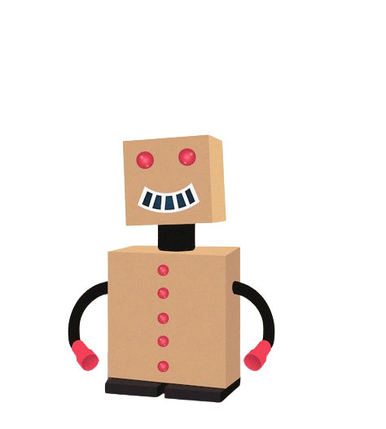
Robot Model Enhancement Challenge
1)Wood as Primary Material:
Choosing wood for the educational robot is intentional for cost-effectiveness and natural strength, aligning with our commitment to sustainability and durability.
2)Safety for Children:
Child safety is our priority in the educational robot's design. Rounded edges, non-toxic finishes, and wooden components create a secure learning space.

Slide 12
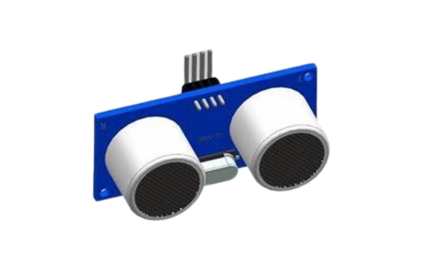
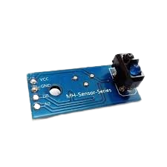
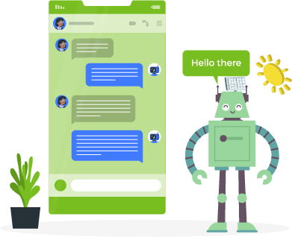
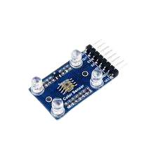
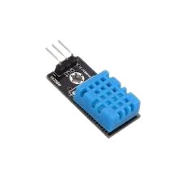
IOT Sensors
Our ChatBot
Ultrasonic Distance Sensor
Infrared (IR) Line Sensor
Color Sensor
Temperature and Humidity Sensor

Slide 13

Business Model Canvas
Key Partners | Key Activities | Value Proposition | Customer Relationships | Customer Segments
Educational Institutions Community Organizations Technology Providers MDF Wood Suppliers | Educational Content Creation Robot Kit Production Free Workshops and Programs Community Events | Educational Robot Kit (Made of MDF Wood) Free Workshops and Programs Affordable and Eco-friendly | Educational Partnerships Parental Involvement | Primary: Primary school students Secondary: Parents, educational institutions
Educational Institutions Community Organizations Technology Providers MDF Wood Suppliers | Key Resources | Key Metrics | Channels | Primary: Primary school students Secondary: Parents, educational institutions
Educational Institutions Community Organizations Technology Providers MDF Wood Suppliers | Educational Content MDF Wood Material Technological Infrastructure Community Partnerships |  | Online Platform Educational Institutions Community Events | Primary: Primary school students Secondary: Parents, educational institutions
Sales:
- Monthly Kit Sales
- Revenue per Kit
- Customer Acquisition Cost (CAC)
Engagement:
- Workshop Attendance
- Online Platform Interaction
Impact:
- Learning Outcomes
- Participant Satisfaction
Financial:
- Total Revenue
- Cost of Goods Sold (COGS)
Cost Structure | Revenue Streams
MDF Wood Material Costs Robot Kit Production Costs Marketing and Outreach | Wooden Educational Robot Kit Sales Subscription Model Additional Accessories

Slide 14
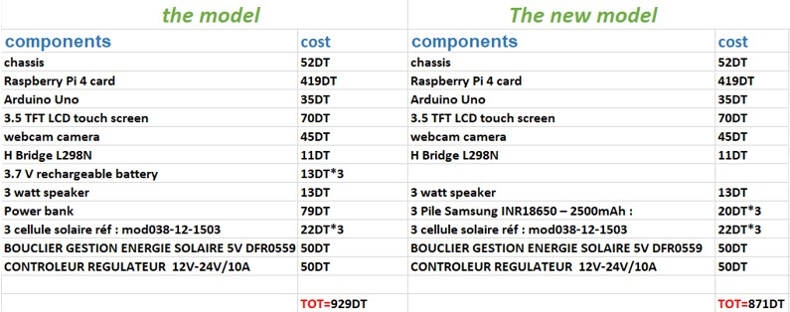
Budgeting

Slide 15
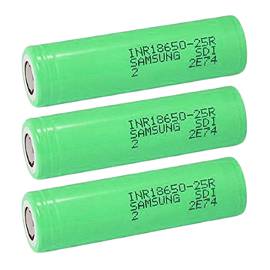
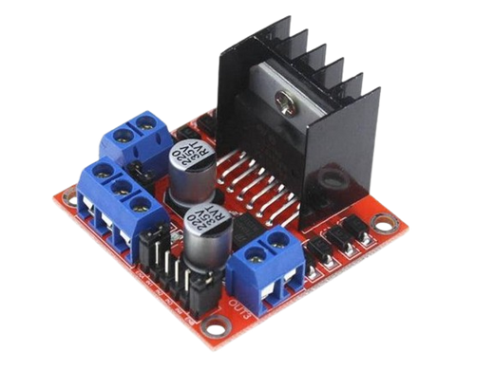
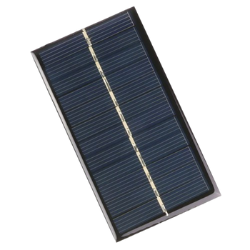
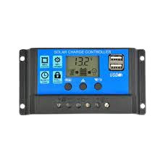
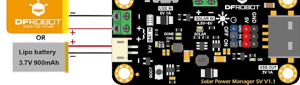
USED MATERIEL :
3 Pile Samsung INR18650 – 2500mAh
Module L298N
3 cellule solaire 12v 150ma 110x110mm
CONTROLEUR REGULATEUR DE CHARGE SOLAIRE 12V-24V/10A AFFICHAGE LCD
BOUCLIER GESTION ENERGIE SOLAIRE 5V DFR0559

Slide 16


Conclusion :
Minimizing the weight of a robot can
lead to several benefits, including:
Reduced power consumption
Reduced battery capacity
More efficient energy system

Slide 17



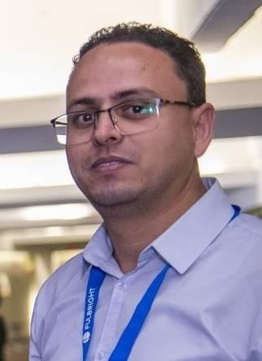
Meet Our Team
Lyna Haouel
Issra Ben Aissia
Nour Chargui
Mr
Manef Bourogaoui

Slide 18
thank you

